Slide 1
Heritage Graph
Nabin Oli, Niraj Karki
Research Interns at CAIR-Nepal
1 February 2025
Research Writing (Online) Hosted by IEEE Pulchowk Campus & CAIR-Nepal

Slide 2
Our roots, our heritage, and our history. Only then can we navigate the future with purpose and clarity
“To chart meaningful path forward, we must first understand where we come from.”

Slide 3
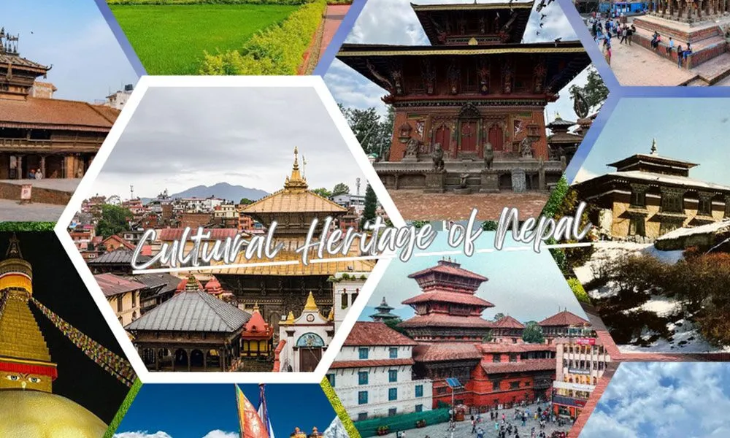

Slide 4
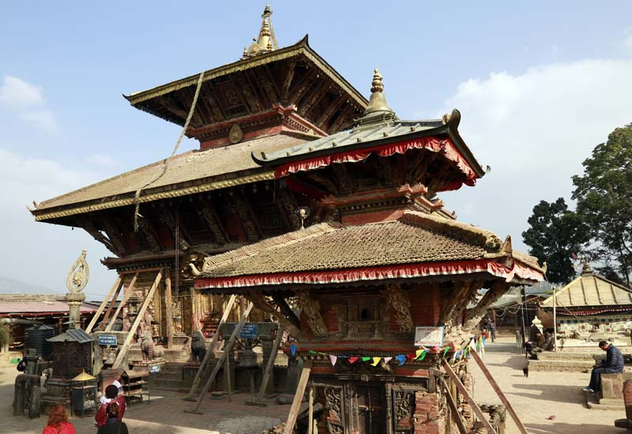
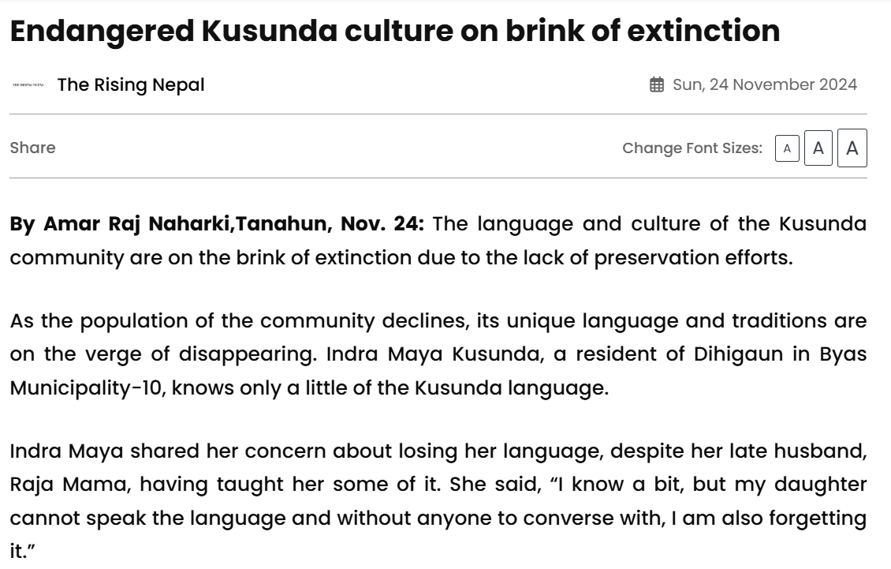
Changunarayan Temple
Source: The rising Nepal

Slide 5
Outline
Motivation
Heritage Graph
Why Heritage Graph?
Knowledge Graphs
Architecture
Example Workflow
Progress

Slide 6
Motivation
Cultural heritages are at the risk of loss, degradation or inaccessibility
Cultural heritages are backbone of humanity’s collective memory and identity
Digitization not only saves but also decentralizes the access
Preserving local heritage empowers Nepali communities to reclaim their narratives, educate youth, and drive cultural tourism sustainably.

Slide 7
What is Heritage Graph?
Why it is important?
A project by CAIR Nepal to preserve and promote Nepal’s cultural heritage using Knowledge Graphs.
Nepal’s rich cultural heritage is at risk of being lost due to globalization, urbanization, and lack of documentation. Heritage Graph aims to digitize, organize, and make this heritage accessible to future generations.

Slide 8
Objectives of Heritage Graph
Digitize and preserve
Knowledge Graphs of Nepali cultural heritage
Use AI to analyze and generate insights from cultural datasets.
Make cultural heritage accessible to researchers, educators, and the public

Slide 9
Why Heritage Graph?
Preserves and digitizes cultural Heritage
Promotes Cultural Awareness and Education
Drives tourism and Economic Growth
Leverages cutting-edge technology
Supports research and innovation
Foster global collaboration and leadership

Slide 10
What is Knowledge Graph?
A structured representation of knowledge using nodes (entities) and edges (relationships).
Example:
Nodes: Temples, Festivals, Historical Figures
Edges: “Built by”, “Celebrated in”, “Influenced by”

Slide 11
Why knowledge graphs?
Opens the doors for advanced and interdisciplinary research
Provides human comprehensible and machine readable format data
Enables AI/ML integration and supports semantic search capabilities
Can be queried
Intuitive visualizations
Captures the relationship between entities well

Slide 12
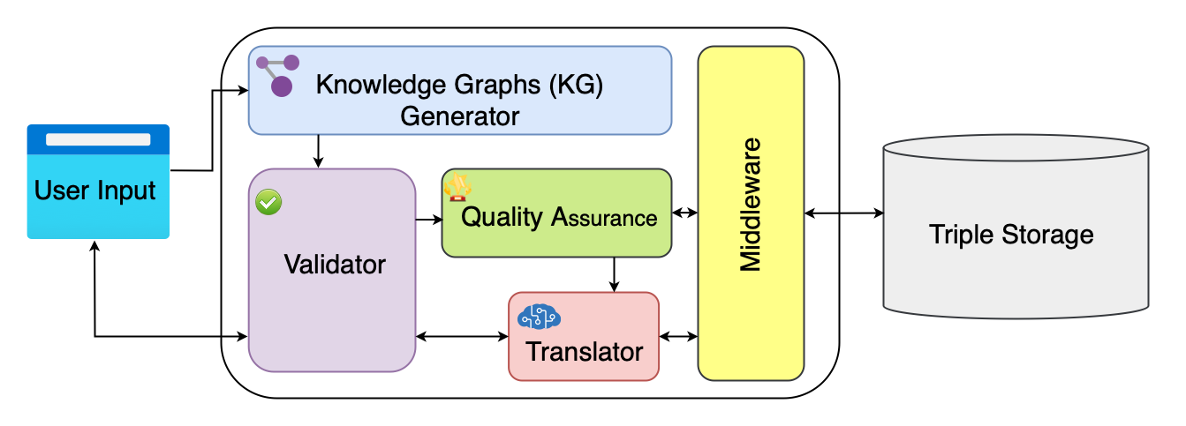
Architecture

Slide 13
User Inputs
Digitized artifacts (texts, images, audio/video recordings).
Historical records, oral traditions, academic research.
Community contributions (local stories, rituals, festivals). Function:
Collects heterogeneous data (e.g., Local manuscripts, Indigenous folk songs, temple inscriptions).
Supports multiple formats (text, CSV, JSON, images) and languages (Nepali, Maithili, English).

Slide 14
Knowledge graph generator
Purpose: Converts raw input into structured triples (subject-predicate-object).
Entity Extraction: Identifies key entities (e.g., Pashupatinath Temple, Dashain Festival).
Relationship Mapping: Links entities via semantic relationships (e.g., "Dashain isCelebratedIn Nepal").
Ontology Alignment: Uses a pre-defined cultural heritage ontology to standardize terms (e.g., festival, deity, artifact).
Tools: NLP libraries (e.g., spaCy), custom scripts for non-text data (images/audio metadata).

Slide 15
Validator
Purpose: Ensures logical consistency and accuracy.
Schema Validation: Confirms triples align with the project’s ontology (e.g., festival → occursAt → location).
Data Integrity: Flags contradictions (e.g., "Lumbini isIn India" vs. "Lumbini isIn Nepal").
Source Credibility: Cross-references data with trusted repositories (e.g., National Archives of Nepal).

Slide 16
Quality Assurance (QA)
Purpose: Enhances data reliability and completeness.
Automated QA: Runs rule-based checks (e.g., mandatory fields for artifacts).
Human-in-the-Loop: Domain experts (historians, anthropologists) review ambiguous entries (e.g., conflicting ritual interpretations).
Feedback Loop: Updates the ontology/KG based on QA findings.

Slide 17
Translator
Purpose: Makes the KG accessible to diverse audiences.
Multilingual Support: Translates entity labels and descriptions into regional languages (Nepali, Bhojpuri, Sherpa).
Semantic Context Preservation: Ensures translations retain cultural nuance (e.g., "Guthi" ≠ "committee" but a unique social system).
Cross-Lingual Linking: Connects equivalent terms across languages (e.g., "Tihar" ↔ "Deepawali").

Slide 18
Middleware
Purpose: Acts as a bridge between components and external systems.
API Integration: Connects to external databases (e.g., UNESCO, Wikidata) for enrichment.
Workflow Orchestration: Manages data flow between KG Generator, Validator, and Triple Storage.
Security Layer: Authenticates user contributions and restricts sensitive data access.

Slide 19
Triple Storage
Purpose: Stores and manages the finalized knowledge graph.
Database: RDF triple store (e.g., Apache Jena, GraphDB).
Querying: Supports SPARQL for complex queries (e.g., "Show all artifacts linked to the Malla Dynasty").
Interoperability: Exports data in standard formats (RDF, JSON-LD) for integration with global platforms like Europeana.

Slide 20
Architecture
Fig. Architecture of Heritage Graph Platform

Slide 21
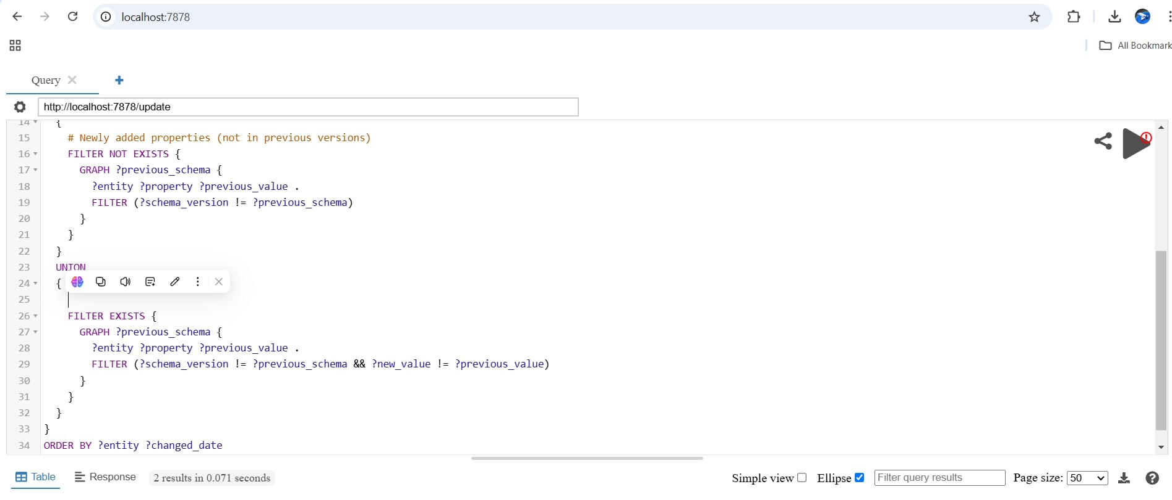
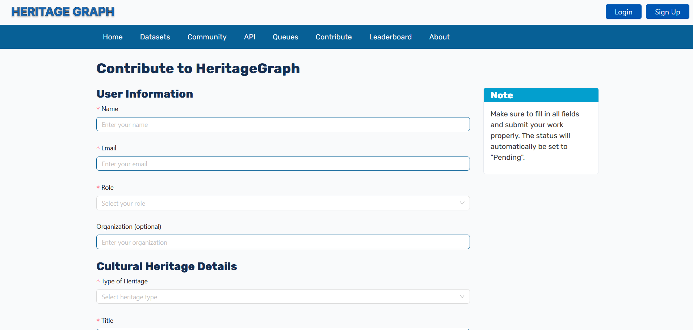
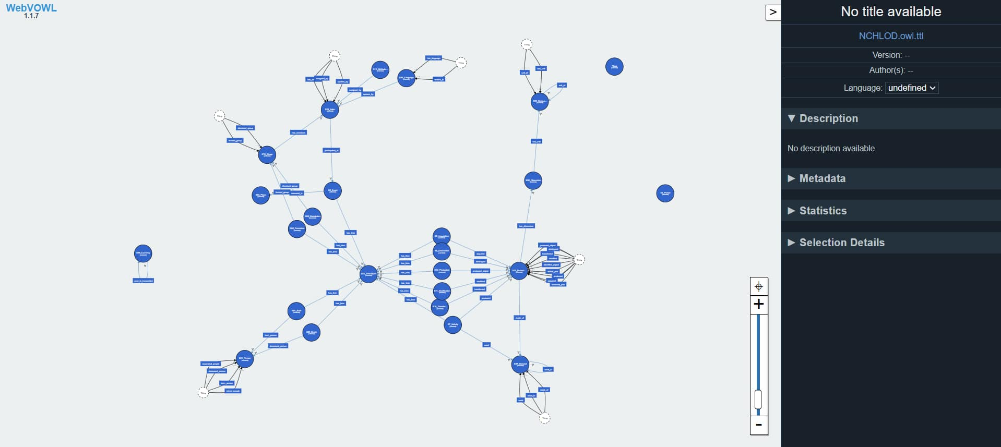
Progress:
Development of Heritage Graph platform
Developed flexible and extensible ontology design using LinkML
Leveraged Oxiograph for the Knowledge Graph database

Slide 22
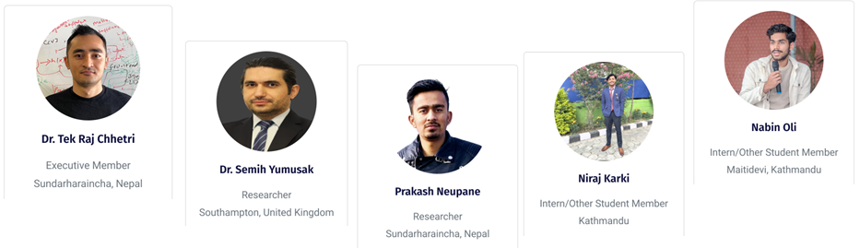

Heritage Graph
People behind Heritage Graph

Slide 23
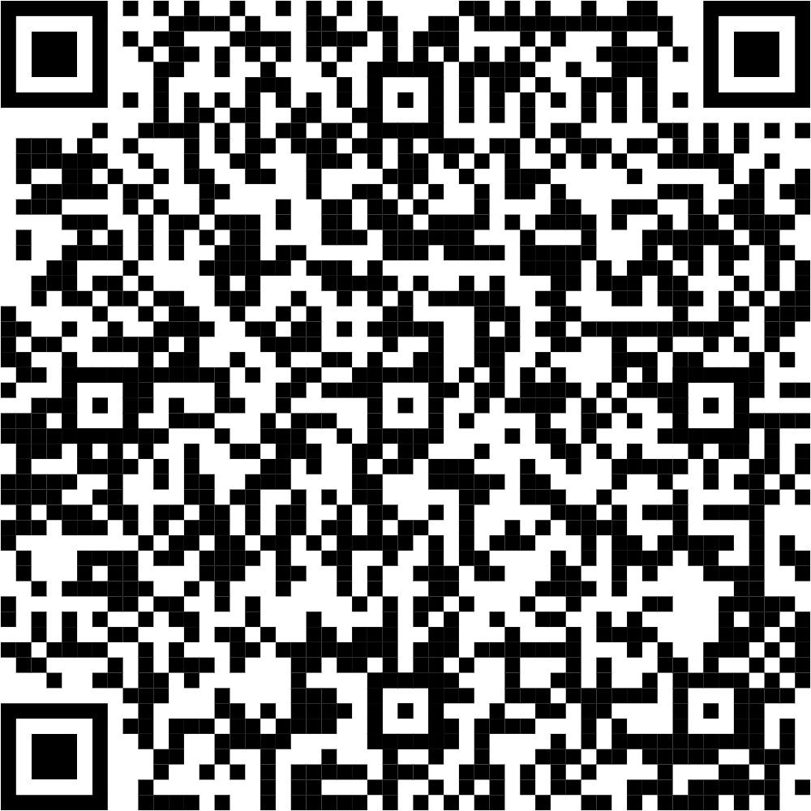
Thank You

